Slide 1
Chapter 4
Combinational Logic

Slide 2
TOPIC 1
Analysis of Combinational Circuit

Slide 3
Logic circuits for digital systems may be combinational or sequential.
A combinational circuit consists of logic gates whose outputs at any time are determined from only the present combination of inputs.
A sequential circuit contains memory elements. The outputs are a function of the current inputs and the state of the memory elements.

Slide 4
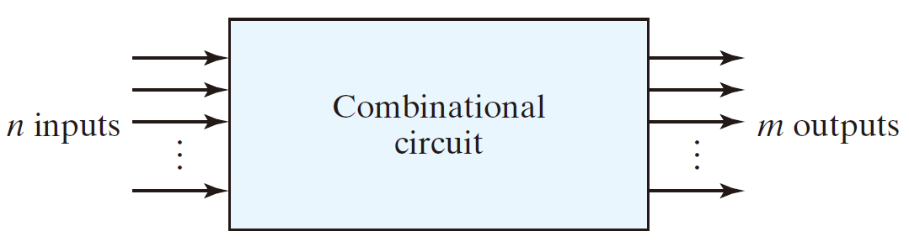
A combinational circuits
  2^{n} possible combinations of input values

Slide 5
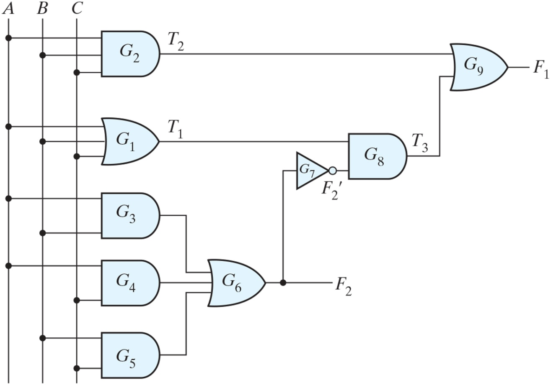
  F₂ = AB + AC + BC

Slide 6
  F₂ = AB + AC + BC
  T₁ = A + B + C

Slide 7
  F₂ = AB + AC + BC
  T₁ = A + B + C
  T₂ = ABC

Slide 8
  F₂ = AB + AC + BC
  T₁ = A + B + C
  T₂ = ABC
  T₃ = F₂’T₁

Slide 9
  F₂ = AB + AC + BC
  T₁ = A + B + C
  T₂ = ABC
  T₃ = F₂’T₁
  F₁ = T₃ + T₂

Slide 10
F₁ = T₃ + T₂
  F₂ = AB + AC + BC
  T₁ = A + B + C
  T₂ = ABC
  T₃ = F₂’T₁
  F₁ = T₃ + T₂

Slide 11
F₁ = T₃ + T₂ = F₂’T₁ + ABC
  F₂ = AB + AC + BC
  T₁ = A + B + C
  T₂ = ABC
  T₃ = F₂’T₁
  F₁ = T₃ + T₂

Slide 12
F₁ = T₃ + T₂ = F₂’T₁ + ABC
= (AB + AC + BC)’(A + B + C) + ABC
  F₂ = AB + AC + BC
  T₁ = A + B + C
  T₂ = ABC
  T₃ = F₂’T₁
  F₁ = T₃ + T₂

Slide 13
F₁ = T₃ + T₂ = F₂’T₁ + ABC
= (AB + AC + BC)’(A + B + C) + ABC
= (A’ + B’)(A’ + C’)(B’ + C’)(A + B + C) + ABC
  F₂ = AB + AC + BC
  T₁ = A + B + C
  T₂ = ABC
  T₃ = F₂’T₁
  F₁ = T₃ + T₂

Slide 14
F₁ = T₃ + T₂ = F₂’T₁ + ABC
= (AB + AC + BC)’(A + B + C) + ABC
= (A’ + B’)(A’ + C’)(B’ + C’)(A + B + C) + ABC
= (A’ + B’C’)(AB’ + AC’ + BC’ + B’C) + ABC
  F₂ = AB + AC + BC
  T₁ = A + B + C
  T₂ = ABC
  T₃ = F₂’T₁
  F₁ = T₃ + T₂

Slide 15
F₁ = T₃ + T₂ = F₂’T₁ + ABC
= (AB + AC + BC)’(A + B + C) + ABC
= (A’ + B’)(A’ + C’)(B’ + C’)(A + B + C) + ABC
= (A’ + B’C’)(AB’ + AC’ + BC’ + B’C) + ABC
= A’BC’ + A’B’C + AB’C’ + ABC
  F₂ = AB + AC + BC
  T₁ = A + B + C
  T₂ = ABC
  T₃ = F₂’T₁
  F₁ = T₃ + T₂

Slide 16
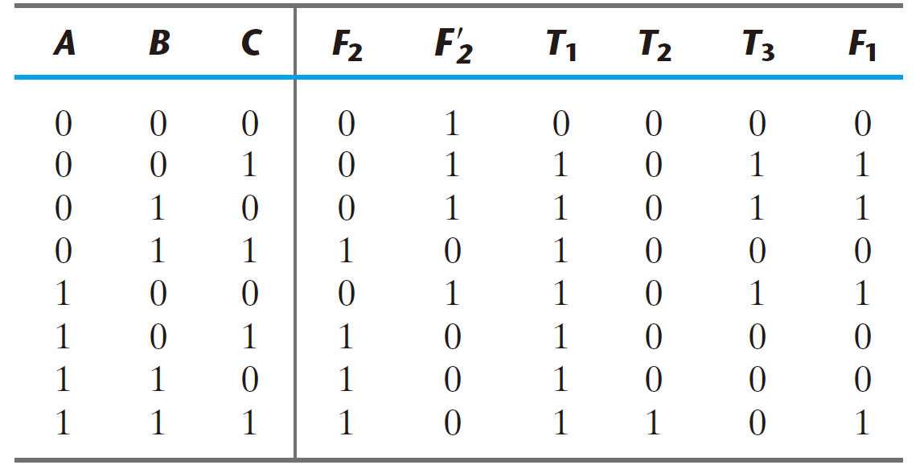
True Table

Slide 17
Design Procedure
  State the problem (system spec.)
  Determine the inputs and outputs
  The input and output variables are assigned symbols
  Derive the truth table
  Derive the simplified Boolean functions
  Draw the logic diagram and verify the correctness

Slide 18
TOPIC 2
Binary Adder-Subtractor

Slide 19
Half adder
  0 + 0 = 00 ; 0 + 1 = 01 ; 1 + 0 = 01 ; 1 + 1 = 10
x
y
 |  | 1
+ |  | 1
 | 1 | 0
+
C
S

Slide 20
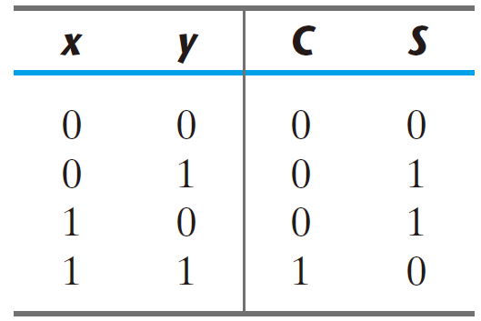
Half adder
  0 + 0 = 0 ; 0 + 1 = 1 ; 1 + 0 = 1 ; 1 + 1 = 10
  two input variables: x, y
  two output variables: C (carry), S (sum)
  truth table
x
y
+
C
S

Slide 21
Half adder
  S = x’y + xy’
  C = xy

Slide 22
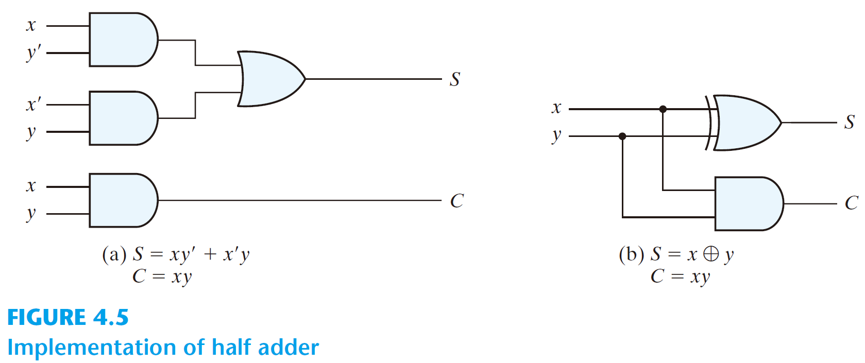
Half adder
  S = x’y + xy’
  C = xy

Slide 23
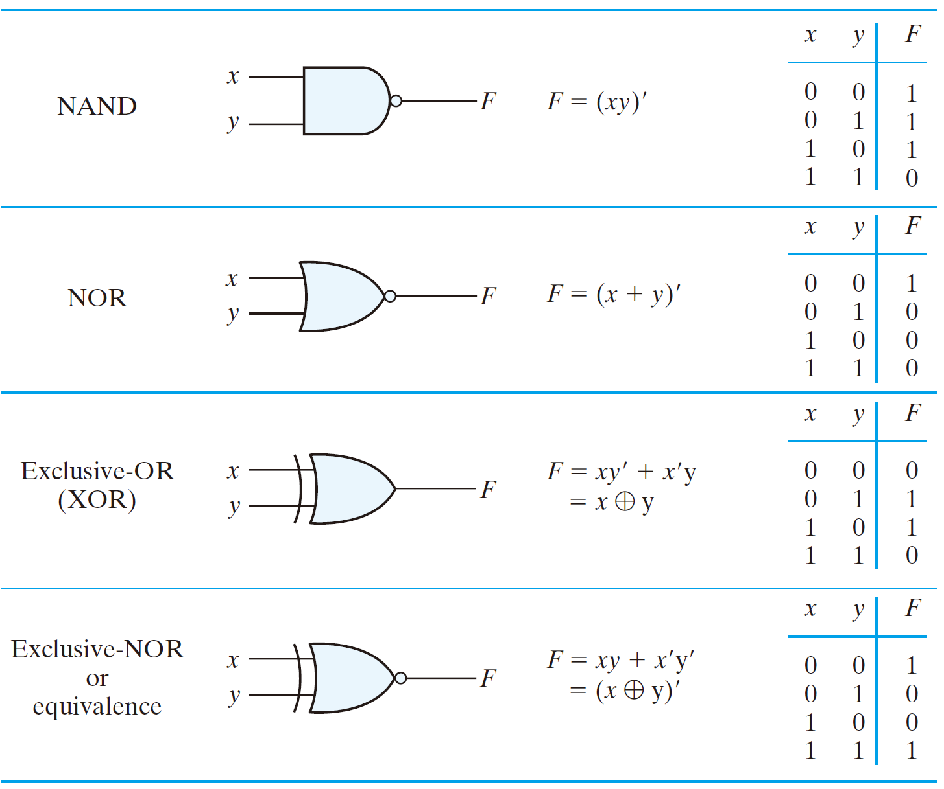
Half adder
  S = x’y + xy’ = x ⊕ y

Slide 24
Half adder
  S = x ⊕ y
  C = xy

Slide 25
Full-Adder
Carry out
Carry in
x
y
 |  | 1 | 1 | 1
 |  | 0 | 0 | 1 | 1
+ |  | 0 | 1 | 0 | 1
 |  | 1 | 0 | 0 | 0
+
C
z
S
  The arithmetic sum of three input bits
  Three input bits
    x, y: two significant bits
    z: the carry bit from the previous lower significant bit
  Two output bits: C, S

Slide 26
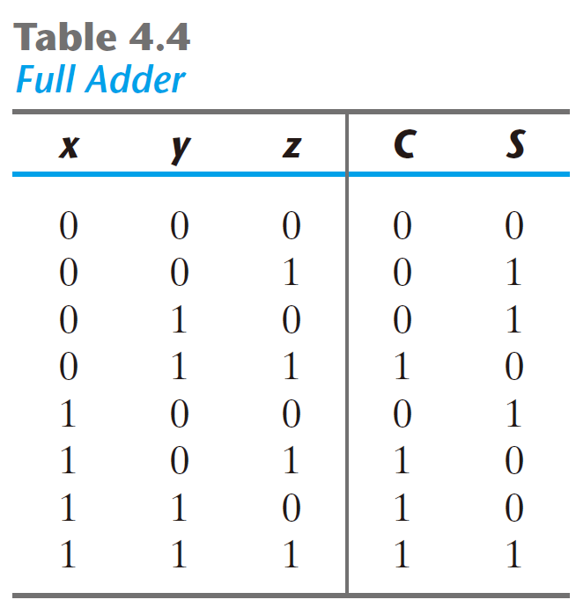
Full-Adder

Slide 27
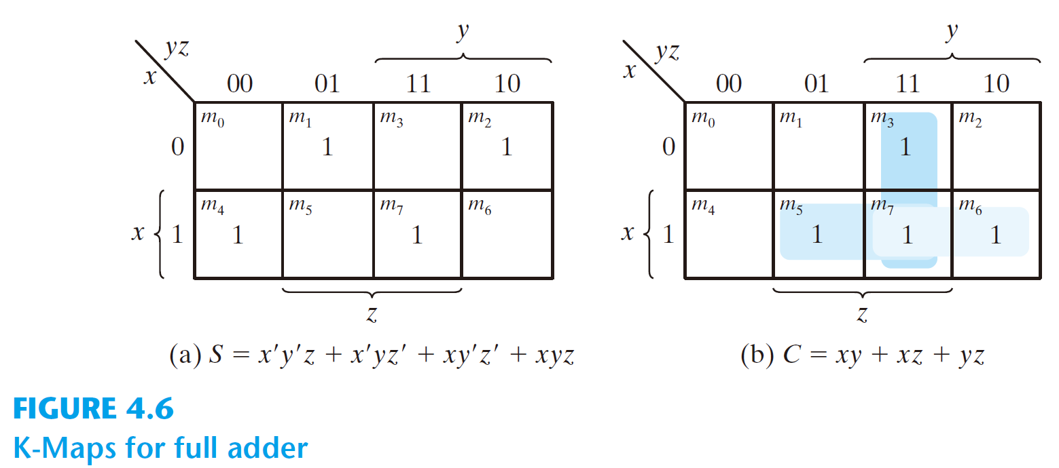
Full-Adder

Slide 28
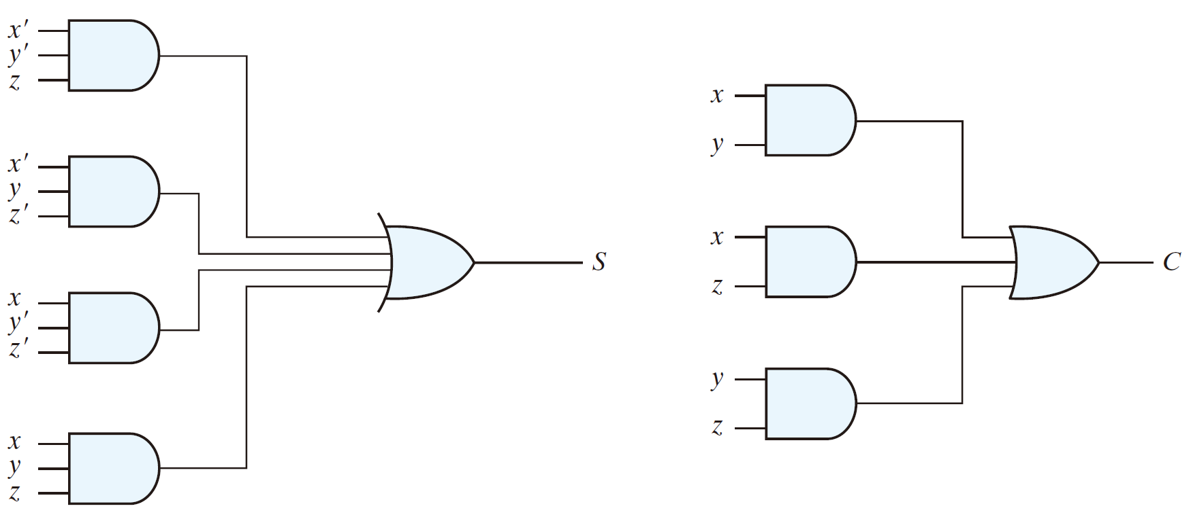
Full-Adder

Slide 29
Full-Adder
  S = x’y’z + x’yz’ + xy’z’ + xyz
  S = z ⊕ (x ⊕ y)
  = z ⊕ (xy’ + x’y)’
  = z’(xy’ + x’y) + z(xy’ + x’y)’
  = z’xy’ + z’x’y + z((x’ + y)(x + y’)) = xy’z’ + x’yz’ + xyz + x’y’z

Slide 30
Full-Adder
  C = xy + xz + yz
  = xy + xyz + xy’z + xyz + x’yz
  = xy + z(xy’ + x’y)
  = xy + z(x ⊕ y)

Slide 31
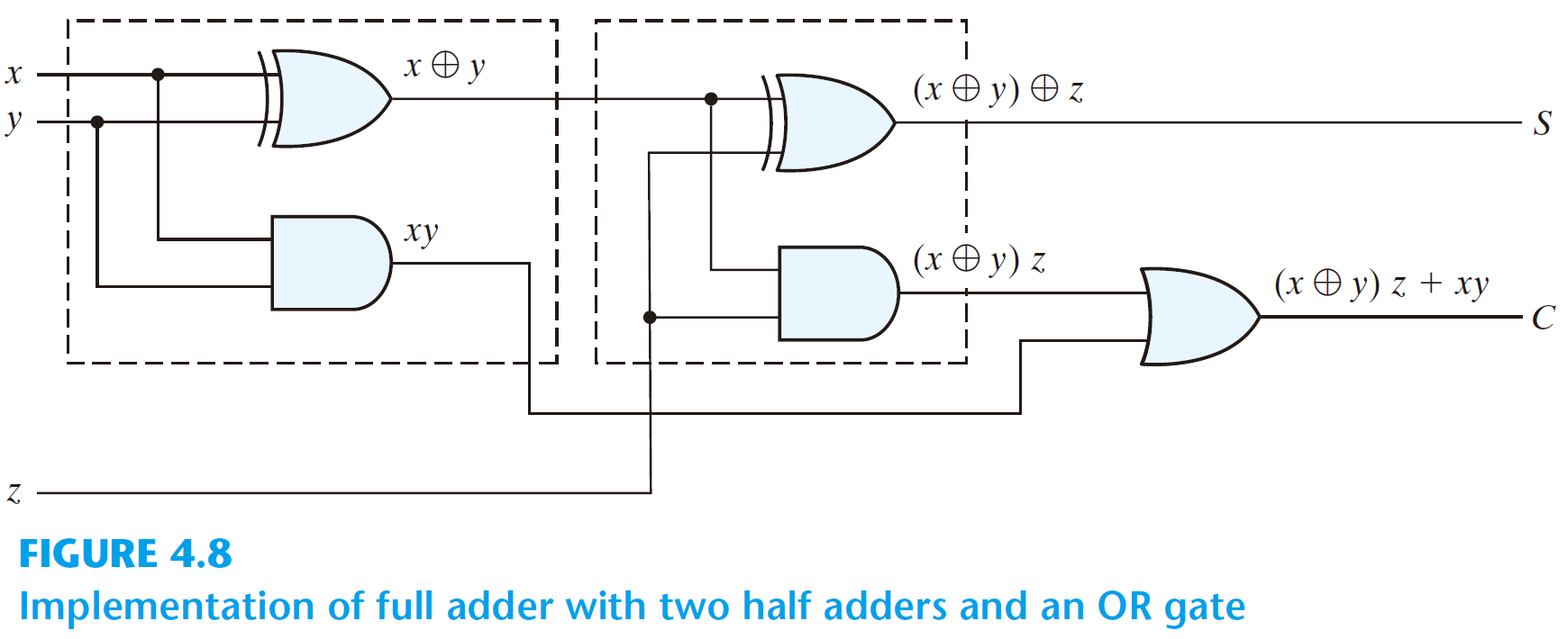
Full-Adder
S = z ⊕ (x ⊕ y)
  C = xy + z(x ⊕ y)

Slide 32
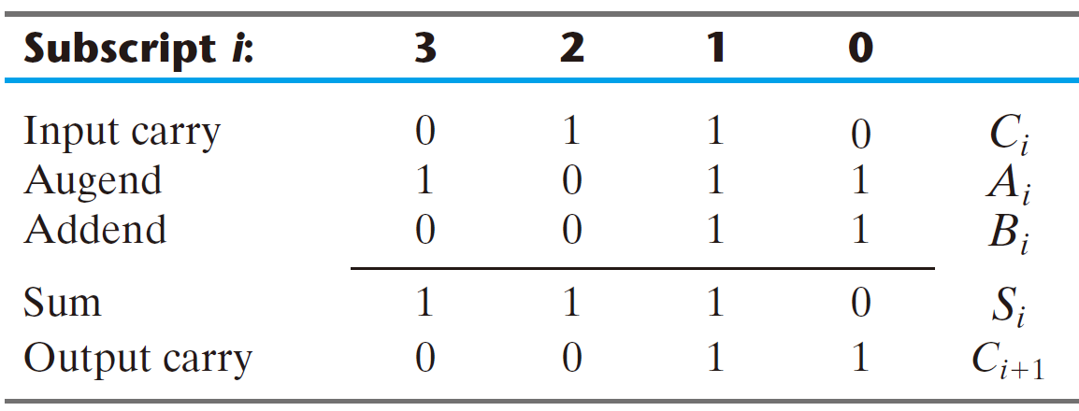
4-bit Binary adder

Slide 33
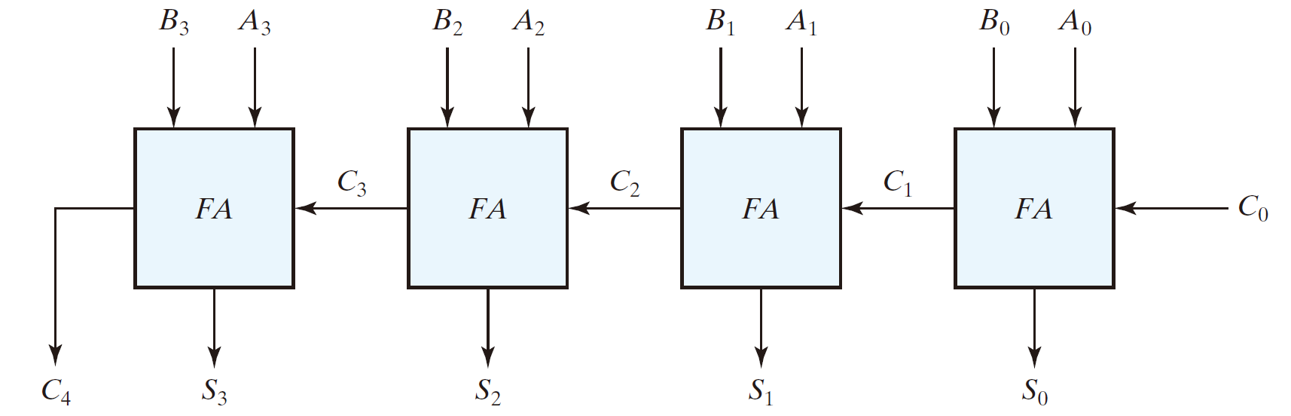
4-bit Binary adder

Slide 35
1
0
1
1

Slide 36
0
1
0
0
1
1
1
1

Slide 37
0
1
0
0
1
1
1
1
0

Slide 38
0
1
0
0
1
1
1
1
1
0
0

Slide 39
0
1
0
0
1
1
1
1
1
1
0
1
0

Slide 40
0
1
0
0
1
1
1
1
0
1
1
0
1
1
0

Slide 41
0
1
0
0
1
1
1
1
0
1
1
0
0
1
1
1
0

Slide 42
Subtraction
 | 0 | 1 | 1 | 1 |  | 7
- | 0 | 1 | 0 | 0 |  | 4
 | 0 | 0 | 1 | 1 |  | 3

Slide 43
Subtraction
7 – 4 = 7 + (-4) = 7 + 2’s complement of 4
2’s complement of (0100) = 1011 + 1 = 1100

Slide 44
Subtraction
7 – 4 = 7 + (-4) = 7 + 2’s complement of 4
2’s complement of (0100) = 1011 + 1 = 1100
 | 0 | 1 | 1 | 1 |  | 7
+ | 1 | 1 | 0 | 0 |  | -4
1 | 0 | 0 | 1 | 1

Slide 45
Subtraction
7 – 4 = 7 + (-4) = 7 + 2’s complement of 4
2’s complement of (0100) = 1011 + 1 = 1100
 | 0 | 1 | 1 | 1 |  | 7
+ | 1 | 1 | 0 | 0 |  | -4
1 | 0 | 0 | 1 | 1 |  | 3
x

Slide 46
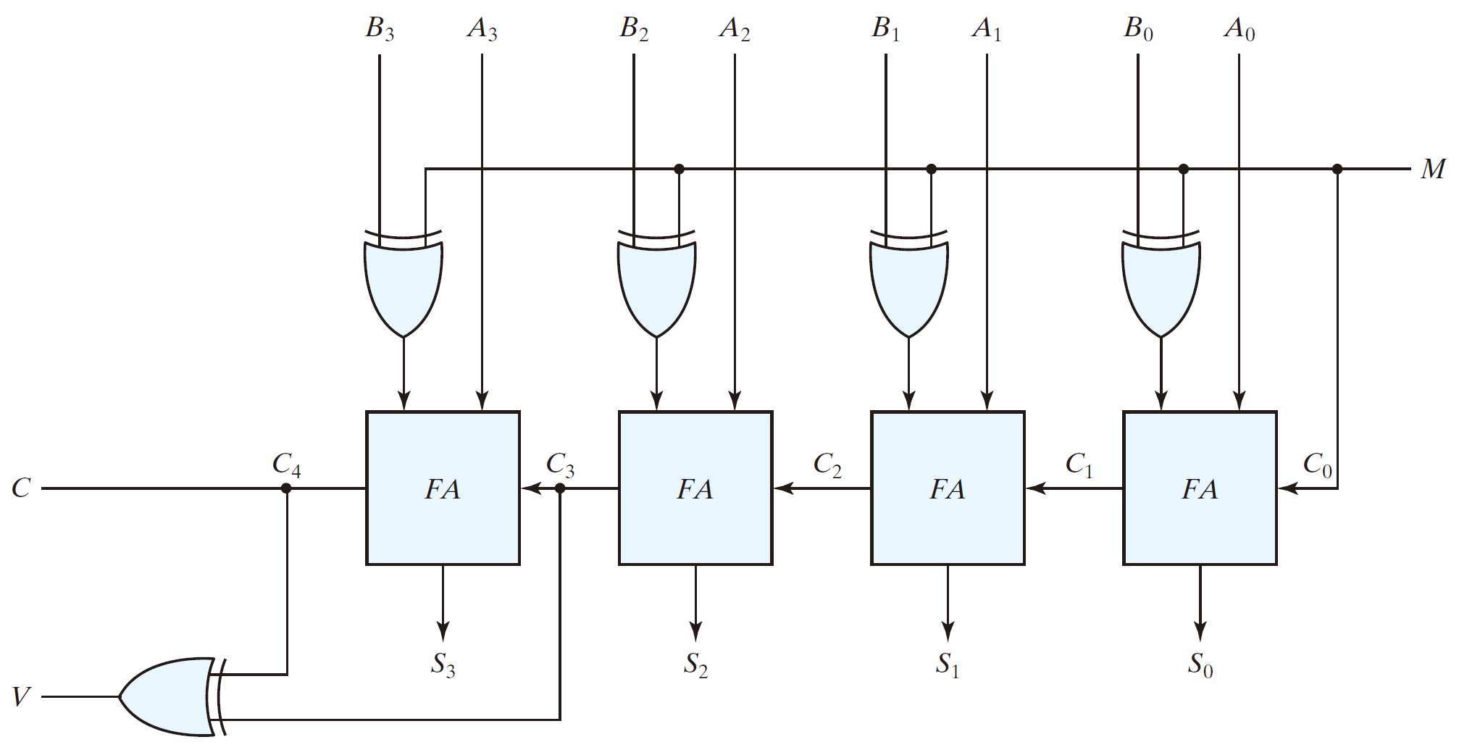
4-bit Binary subtractor

Slide 47
x
x
x
x’
0
1

Slide 48
4-bit Binary subtractor
7 – 4

Slide 49
4-bit Binary subtractor
7 – 4
0
1
1
1

Slide 50
4-bit Binary subtractor
7 – 4
0
0
1
1
0
1
0
1

Slide 51
4-bit Binary subtractor
7 – 4
0
0
1
1
0
1
0
1
1

Slide 52
4-bit Binary subtractor
7 – 4
0
0
1
1
0
1
0
1
1
1
0
1
1

Slide 53
4-bit Binary subtractor
7 – 4
0
0
1
1
0
1
0
1
1
1
0
1
1
1
1

Slide 54
4-bit Binary subtractor
7 – 4
0
0
1
1
0
1
0
1
1
1
0
1
1
1
1
1
1

Slide 55
4-bit Binary subtractor
7 – 4
0
0
1
1
0
1
0
1
1
1
0
1
1
1
1
1
0
1
1

Slide 56
4-bit Binary subtractor
7 – 4
0
0
1
1
0
1
0
1
1
1
0
1
1
1
1
1
1
0
0
1
1

Slide 57
4-bit Binary subtractor
7 – 4
0
0
1
1
0
1
0
1
1
1
0
1
1
1
1
1
1
0
0
0
1
1

Slide 58
4-bit Binary subtractor
3 + 4

Slide 59
4-bit Binary subtractor
3 + 4
0
0
1
1

Slide 60
4-bit Binary subtractor
3 + 4
0
0
1
0
0
1
0
1

Slide 61
4-bit Binary subtractor
3 + 4
0
0
1
0
0
1
0
1
0

Slide 62
4-bit Binary subtractor
3 + 4
0
0
1
0
0
1
0
1
0
0
1
0
0

Slide 63
4-bit Binary subtractor
3 + 4
0
0
1
0
0
1
0
1
0
0
1
0
0
0
1

Slide 64
4-bit Binary subtractor
3 + 4
0
0
1
0
0
1
0
1
0
0
1
0
0
0
0
1
1

Slide 65
4-bit Binary subtractor
3 + 4
0
0
1
0
0
1
0
1
0
0
1
0
0
0
0
0
1
1
1

Slide 66
4-bit Binary subtractor
3 + 4
0
0
1
0
0
1
0
1
0
0
1
0
0
0
0
0
0
0
1
1
1

Slide 67
4-bit Binary subtractor
3 + 4
0
0
1
0
0
1
0
1
0
0
1
0
0
0
0
0
0
0
0
1
1
1

Slide 68
Overflow
  The range of 4-bit 2’s complement number: -8 ~ +7
2’s | Decimal | 2’s | Decimal
0000 | 0 | 1000 | -8
0001 | 1 | 1001 | -7
0010 | 2 | 1010 | -6
0011 | 3 | 1011 | -5
0100 | 4 | 1100 | -4
0101 | 5 | 1101 | -3
0110 | 6 | 1110 | -2
0111 | 7 | 1111 | -1

Slide 69
Overflow | Overflow
Non-overflow | Non-overflow

Slide 70
Overflow
  The storage is limited
  Add two positive numbers and obtain a negative number
  Add two negative numbers and obtain a positive number

Slide 71
4-bit Binary subtractor
6 + 5

Slide 72
4-bit Binary subtractor
6 + 5
0
1
1
0

Slide 73
4-bit Binary subtractor
6 + 5
0
0
1
1
0
1
1
0

Slide 74
4-bit Binary subtractor
6 + 5
0
0
1
1
0
1
1
0
0

Slide 75
4-bit Binary subtractor
6 + 5
0
0
1
1
0
1
1
0
0
0
1
0
1

Slide 76
4-bit Binary subtractor
6 + 5
0
0
1
1
0
1
1
0
0
0
1
0
1
0
1

Slide 77
4-bit Binary subtractor
6 + 5
0
0
1
1
0
1
1
0
0
0
1
0
1
0
0
1
1

Slide 78
4-bit Binary subtractor
6 + 5
0
0
1
1
0
1
1
0
0
0
1
0
1
1
0
0
0
1
1

Slide 79
4-bit Binary subtractor
6 + 5
0
0
1
1
0
1
1
0
0
0
1
0
1
0
1
0
0
1
0
1
1

Slide 80
4-bit Binary subtractor
6 + 5
0
0
1
1
0
1
1
0
0
0
1
0
1
0
1
0
0
1
1
0
1
1

Slide 81
TOPIC 3
Multiplier

Slide 82
Binary Multiplier
A₁
A₀
B₁
B₀
2-bit multiplier
P₃
P₂
P₁
P₀

Slide 83
A₁ | A₀ | B₁ | B₀ | P₃ | P₂ | P₁ | P₀
0 | 0 | 0 | 0 | 0 | 0 | 0 | 0
0 | 0 | 0 | 1 | 0 | 0 | 0 | 0
0 | 0 | 1 | 0 | 0 | 0 | 0 | 0
0 | 0 | 1 | 1 | 0 | 0 | 0 | 0
0 | 1 | 0 | 0 | 0 | 0 | 0 | 0
0 | 1 | 0 | 1 | 0 | 0 | 0 | 1
0 | 1 | 1 | 0 | 0 | 0 | 1 | 0
0 | 1 | 1 | 1 | 0 | 0 | 1 | 1
1 | 0 | 0 | 0 | 0 | 0 | 0 | 0
1 | 0 | 0 | 1 | 0 | 0 | 1 | 0
1 | 0 | 1 | 0 | 0 | 1 | 0 | 0
1 | 0 | 1 | 1 | 0 | 1 | 1 | 0
1 | 1 | 0 | 0 | 0 | 0 | 0 | 0
1 | 1 | 0 | 1 | 0 | 0 | 1 | 1
1 | 1 | 1 | 0 | 0 | 1 | 1 | 0
1 | 1 | 1 | 1 | 1 | 0 | 0 | 1

Slide 84
B₁B₀
 | 00 | 01 | 11 | 10
00
01
11 |  |  | 1
10
A₁A₀
P₃ = A₁A₀B₁B₀

Slide 85
B₁B₀
 | 00 | 01 | 11 | 10
00
01
11 |  |  |  | 1
10 |  |  | 1 | 1
A₁A₀
P₂ = A₁A₀B₁ + A₁B₁B₀

Slide 86
B₁B₀
 | 00 | 01 | 11 | 10
00
01 |  |  | 1 | 1
11 |  | 1 |  | 1
10 |  | 1 | 1
A₁A₀
P₁ = A₁B₁B₀ + A₁A₀B₀ + A₁A₀B₁ + A₀B₁B₀

Slide 87
B₁B₀
 | 00 | 01 | 11 | 10
00
01 |  | 1 | 1
11 |  | 1 | 1
10
A₁A₀
P₀ = A₀B₀

Slide 88
P₃ = A₁A₀B₁B₀
P₂ = A₁A₀B₁ + A₁B₁B₀
P₁ = A₁B₁B₀ + A₁A₀B₀ + A₁A₀B₁ + A₀B₁B₀
P₀ = A₀B₀

Slide 89
n-bit multiplier design
  The truth table has 2^{2n} entries - too cumbersome for large n

Slide 90
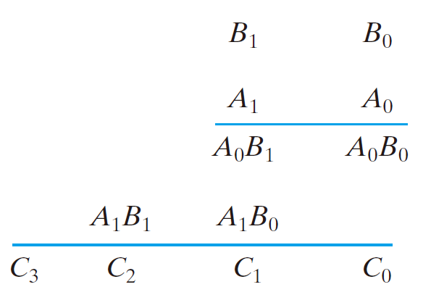

Slide 91
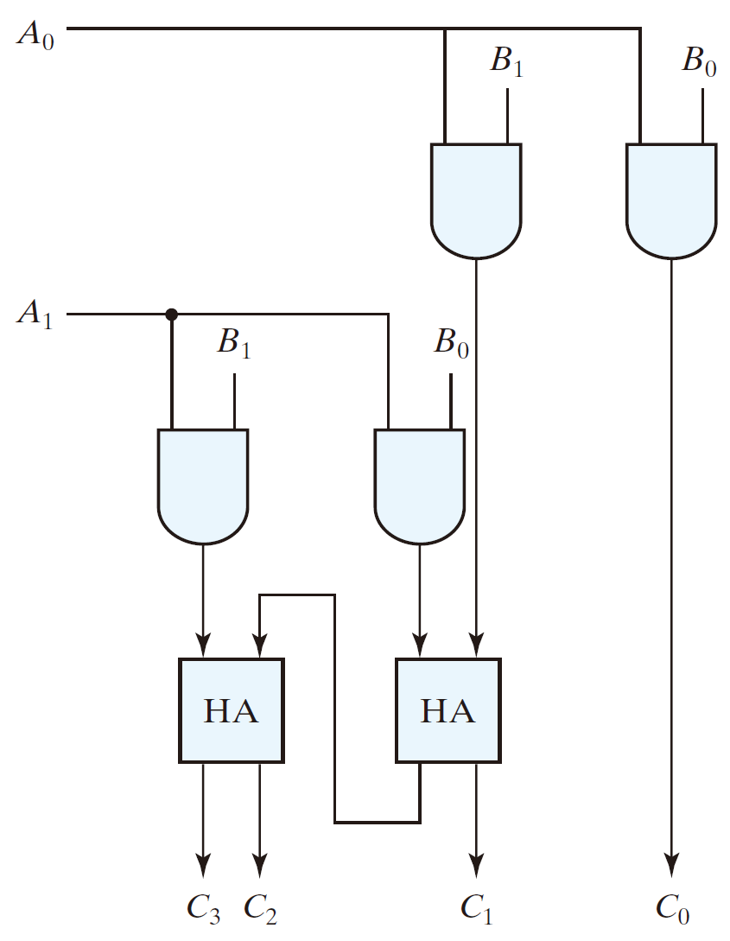

Slide 92
1
0
1
1

Slide 93
1
0
1
1
1
0
1
0

Slide 94
1
0
1
1
1
0
1
0
0
1
1
0

Slide 95
1
0
1
1
1
1
0
1
0
0
1
1
0
1

Slide 96
1
0
1
1
1
1
0
1
0
1
0
0
1
1
0
1
1
0

Slide 97
1
0
1
1
1
1
0
1
0
1
0
0
1
1
0
1
0
1
1
0
1
0

Slide 98
1
0
1
1
1
1
0
1
0
1
0
0
1
1
0
1
0
1
1
0
1
0
0
1
0

Slide 99
1
0
1
1
1
1
0
1
0
1
0
0
1
1
0
1
0
1
1
0
1
0
0
0
1
1
0

Slide 100
4-bit by 3-bit binary multiplier
 |  | B₃ | B₂ | B₁ | B₀
× |  |  | A₂ | A₁ | A₀
 |  | A₀B₃ | A₀B₂ | A₀B₁ | A₀B₀
 | A₁B₃ | A₁B₂ | A₁B₁ | A₁B₀
A₂B₃ | A₂B₂ | A₂B₁ | A₂B₀
C₅ | C₄ | C₃ | C₂ | C₁ | C₀
C₆

Slide 101
4-bit by 3-bit binary multiplier
 |  | B₃ | B₂ | B₁ | B₀
× |  |  | A₂ | A₁ | A₀
 |  | A₀B₃ | A₀B₂ | A₀B₁ | A₀B₀
 | A₁B₃ | A₁B₂ | A₁B₁ | A₁B₀
A₂B₃ | A₂B₂ | A₂B₁ | A₂B₀
C₅ | C₄ | C₃ | C₂ | C₁ | C₀
C₆

Slide 102
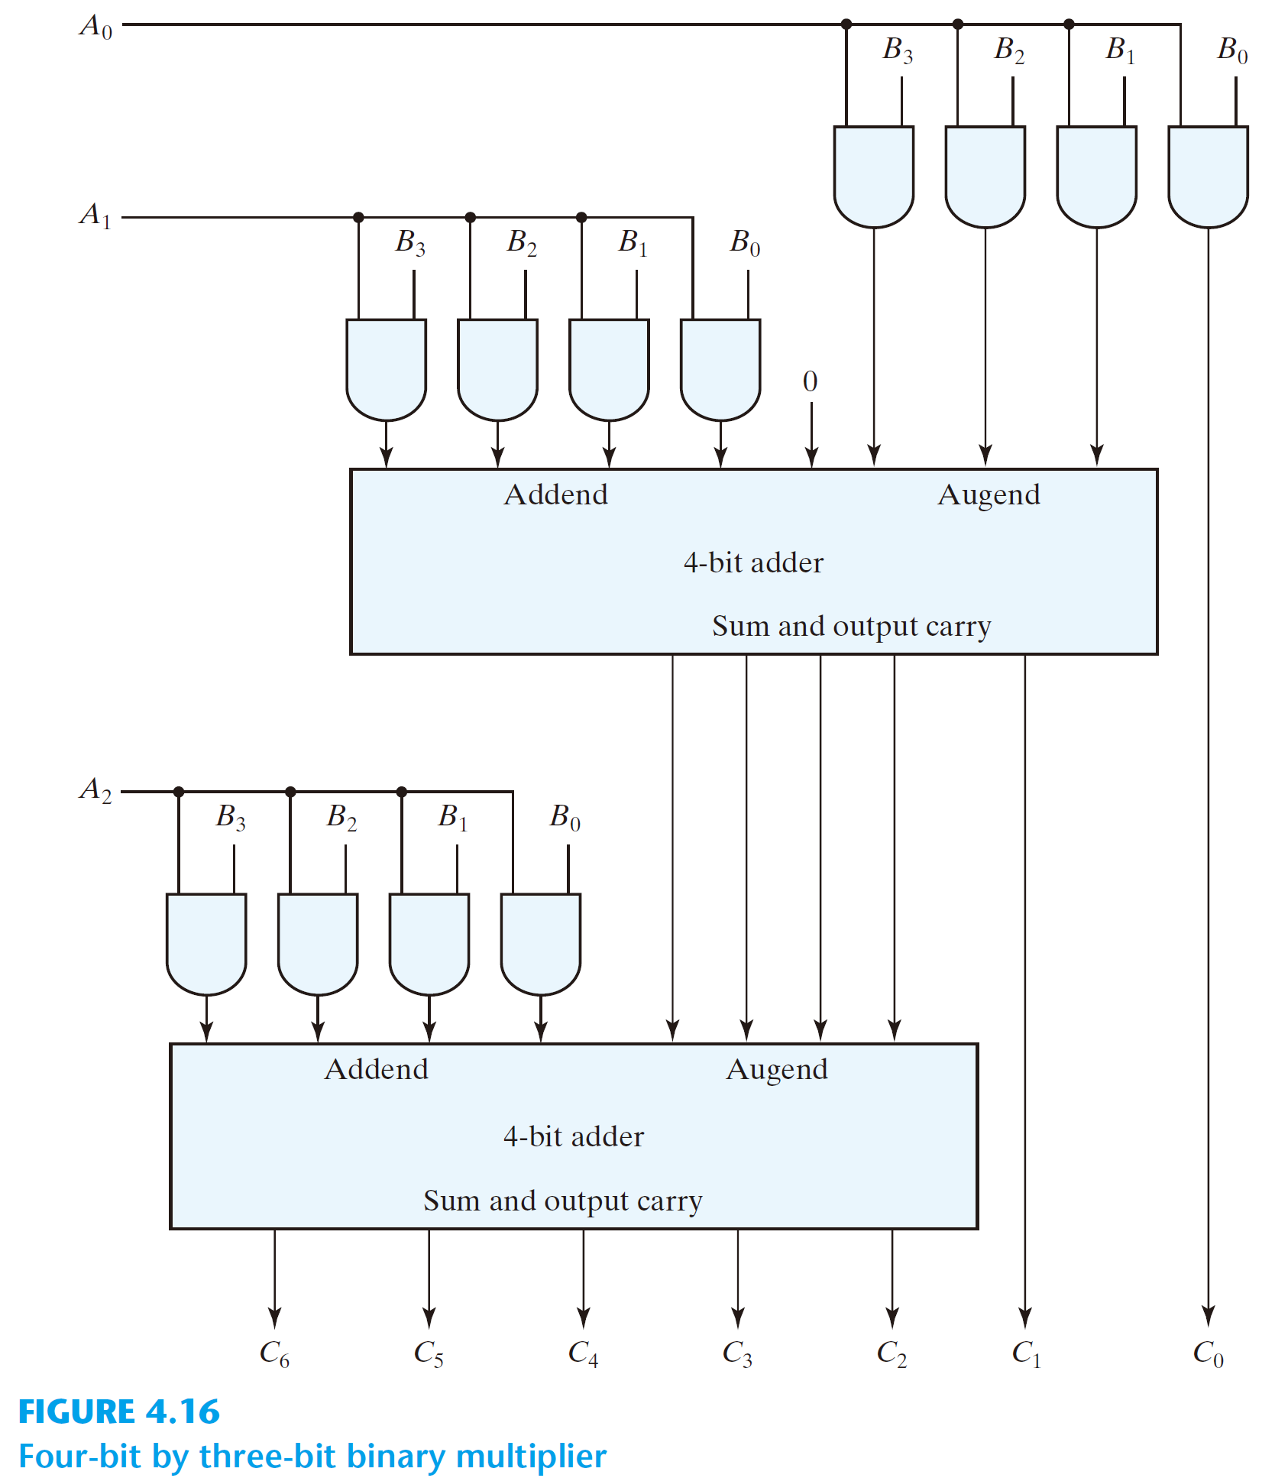
4-bit by 3-bit
binary multiplier

Slide 103
4-bit by 3-bit binary multiplier
 |  | B₃ | B₂ | B₁ | B₀
× |  |  | A₂ | A₁ | A₀
 |  | A₀B₃ | A₀B₂ | A₀B₁ | A₀B₀
 | A₁B₃ | A₁B₂ | A₁B₁ | A₁B₀
A₂B₃ | A₂B₂ | A₂B₁ | A₂B₀
C₅ | C₄ | C₃ | C₂ | C₁ | C₀
C₆

Slide 104
4-bit by 3-bit binary multiplier
 |  | B₃ | B₂ | B₁ | B₀
× |  |  | A₂ | A₁ | A₀
 |  | A₀B₃ | A₀B₂ | A₀B₁ | A₀B₀
 | A₁B₃ | A₁B₂ | A₁B₁ | A₁B₀
A₂B₃ | A₂B₂ | A₂B₁ | A₂B₀
C₅ | C₄ | C₃ | C₂ | C₁ | C₀
C₆

Slide 105
4-bit by 3-bit binary multiplier
 |  | B₃ | B₂ | B₁ | B₀
× |  |  | A₂ | A₁ | A₀
 |  | A₀B₃ | A₀B₂ | A₀B₁ | A₀B₀
 | A₁B₃ | A₁B₂ | A₁B₁ | A₁B₀
A₂B₃ | A₂B₂ | A₂B₁ | A₂B₀
C₅ | C₄ | C₃ | C₂ | C₁ | C₀
C₆

Slide 106
4-bit by 3-bit binary multiplier
 |  | B₃ | B₂ | B₁ | B₀
× |  |  | A₂ | A₁ | A₀
 |  | A₀B₃ | A₀B₂ | A₀B₁ | A₀B₀
 | A₁B₃ | A₁B₂ | A₁B₁ | A₁B₀
A₂B₃ | A₂B₂ | A₂B₁ | A₂B₀
C₅ | C₄ | C₃ | C₂ | C₁ | C₀
C₆

Slide 107
4-bit by 3-bit binary multiplier
 |  | B₃ | B₂ | B₁ | B₀
× |  |  | A₂ | A₁ | A₀
 | 0 | A₀B₃ | A₀B₂ | A₀B₁ | A₀B₀
 | A₁B₃ | A₁B₂ | A₁B₁ | A₁B₀
A₂B₃ | A₂B₂ | A₂B₁ | A₂B₀
C₅ | C₄ | C₃ | C₂ | C₁ | C₀
C₆

Slide 108
4-bit by 3-bit
binary multiplier

Slide 109
4-bit by 3-bit binary multiplier
 |  | B₃ | B₂ | B₁ | B₀
× |  |  | A₂ | A₁ | A₀
 | 0 | A₀B₃ | A₀B₂ | A₀B₁ | A₀B₀
 | A₁B₃ | A₁B₂ | A₁B₁ | A₁B₀
S₄ | S₃ | S₂ | S₁ | S₀
A₂B₃ | A₂B₂ | A₂B₁ | A₂B₀
C₅ | C₄ | C₃ | C₂ | C₁ | C₀
C₆

Slide 110
4-bit by 3-bit
binary multiplier

Slide 111
4-bit by 3-bit binary multiplier
 |  | B₃ | B₂ | B₁ | B₀
× |  |  | A₂ | A₁ | A₀
 | 0 | A₀B₃ | A₀B₂ | A₀B₁ | A₀B₀
 | A₁B₃ | A₁B₂ | A₁B₁ | A₁B₀
S₄ | S₃ | S₂ | S₁ | S₀
A₂B₃ | A₂B₂ | A₂B₁ | A₂B₀
C₅ | C₄ | C₃ | C₂ | C₁ | C₀
C₆

Slide 112
4-bit by 3-bit
binary multiplier

Slide 113
4-bit by 3-bit binary multiplier
 |  | B₃ | B₂ | B₁ | B₀
× |  |  | A₂ | A₁ | A₀
 | 0 | A₀B₃ | A₀B₂ | A₀B₁ | A₀B₀
 | A₁B₃ | A₁B₂ | A₁B₁ | A₁B₀
S₄ | S₃ | S₂ | S₁ | S₀
A₂B₃ | A₂B₂ | A₂B₁ | A₂B₀
C₅ | C₄ | C₃ | C₂ | C₁ | C₀
C₆

Slide 114
4-bit by 3-bit binary multiplier
 |  | B₃ | B₂ | B₁ | B₀
× |  |  | A₂ | A₁ | A₀
 | 0 | A₀B₃ | A₀B₂ | A₀B₁ | A₀B₀
 | A₁B₃ | A₁B₂ | A₁B₁ | A₁B₀
S₄ | S₃ | S₂ | S₁ | S₀
A₂B₃ | A₂B₂ | A₂B₁ | A₂B₀
C₅ | C₄ | C₃ | C₂ | C₁ | C₀
C₆

Slide 115
4-bit by 3-bit binary multiplier
 |  | B₃ | B₂ | B₁ | B₀
× |  |  | A₂ | A₁ | A₀
 | 0 | A₀B₃ | A₀B₂ | A₀B₁ | A₀B₀
 | A₁B₃ | A₁B₂ | A₁B₁ | A₁B₀
S₄ | S₃ | S₂ | S₁ | S₀
A₂B₃ | A₂B₂ | A₂B₁ | A₂B₀
C₅ | C₄ | C₃ | C₂ | C₁ | C₀
C₆

Slide 116
4-bit by 3-bit binary multiplier
 |  |  | B₃ | B₂ | B₁ | B₀
 | × |  |  | A₂ | A₁ | A₀
 |  | 0 | A₀B₃ | A₀B₂ | A₀B₁ | A₀B₀
 |  | A₁B₃ | A₁B₂ | A₁B₁ | A₁B₀
 | S₄ | S₃ | S₂ | S₁ | S₀
 | A₂B₃ | A₂B₂ | A₂B₁ | A₂B₀
C₆ | C₅ | C₄ | C₃ | C₂ | C₁ | C₀

Slide 117
4-bit by 3-bit
binary multiplier

Slide 118
4-bit by 3-bit
binary multiplier
 |  |  | B₃ | B₂ | B₁ | B₀
× |  |  |  | A₂ | A₁ | A₀
 |  |  | A₀B₃ | A₀B₂ | A₀B₁ | A₀B₀
 |  | A₁B₃ | A₁B₂ | A₁B₁ | A₁B₀
 | A₂B₃ | A₂B₂ | A₂B₁ | A₂B₀
C₆ | C₅ | C₄ | C₃ | C₂ | C₁ | C₀

Slide 119
4-bit by 3-bit
binary multiplier
 |  |  | 1 | 0 | 1 | 0
× |  |  |  | A₂ | A₁ | A₀
 |  |  | A₀B₃ | A₀B₂ | A₀B₁ | A₀B₀
 |  | A₁B₃ | A₁B₂ | A₁B₁ | A₁B₀
 | A₂B₃ | A₂B₂ | A₂B₁ | A₂B₀
C₆ | C₅ | C₄ | C₃ | C₂ | C₁ | C₀

Slide 120
4-bit by 3-bit
binary multiplier
1
0
1
0
 |  |  | 1 | 0 | 1 | 0
× |  |  |  | A₂ | A₁ | A₀
 |  |  | A₀B₃ | A₀B₂ | A₀B₁ | A₀B₀
 |  | A₁B₃ | A₁B₂ | A₁B₁ | A₁B₀
 | A₂B₃ | A₂B₂ | A₂B₁ | A₂B₀
C₆ | C₅ | C₄ | C₃ | C₂ | C₁ | C₀

Slide 121
4-bit by 3-bit
binary multiplier
1
0
1
0
1
0
1
0
 |  |  | 1 | 0 | 1 | 0
× |  |  |  | A₂ | A₁ | A₀
 |  |  | A₀B₃ | A₀B₂ | A₀B₁ | A₀B₀
 |  | A₁B₃ | A₁B₂ | A₁B₁ | A₁B₀
 | A₂B₃ | A₂B₂ | A₂B₁ | A₂B₀
C₆ | C₅ | C₄ | C₃ | C₂ | C₁ | C₀

Slide 122
4-bit by 3-bit
binary multiplier
1
0
1
0
1
0
1
0
 |  |  | 1 | 0 | 1 | 0
× |  |  |  | A₂ | A₁ | A₀
 |  |  | A₀B₃ | A₀B₂ | A₀B₁ | A₀B₀
 |  | A₁B₃ | A₁B₂ | A₁B₁ | A₁B₀
 | A₂B₃ | A₂B₂ | A₂B₁ | A₂B₀
C₆ | C₅ | C₄ | C₃ | C₂ | C₁ | C₀
1
0
1
0

Slide 123
4-bit by 3-bit
binary multiplier
1
0
1
0
1
0
1
0
 |  |  | 1 | 0 | 1 | 0
× |  |  |  | 0 | 1 | 1
 |  |  | A₀B₃ | A₀B₂ | A₀B₁ | A₀B₀
 |  | A₁B₃ | A₁B₂ | A₁B₁ | A₁B₀
 | A₂B₃ | A₂B₂ | A₂B₁ | A₂B₀
C₆ | C₅ | C₄ | C₃ | C₂ | C₁ | C₀
1
0
1
0

Slide 124
4-bit by 3-bit
binary multiplier
1
1
0
1
0
1
1
0
1
0
 |  |  | 1 | 0 | 1 | 0
× |  |  |  | 0 | 1 | 1
 |  |  | A₀B₃ | A₀B₂ | A₀B₁ | A₀B₀
 |  | A₁B₃ | A₁B₂ | A₁B₁ | A₁B₀
 | A₂B₃ | A₂B₂ | A₂B₁ | A₂B₀
C₆ | C₅ | C₄ | C₃ | C₂ | C₁ | C₀
0
1
0
1
0

Slide 125
4-bit by 3-bit
binary multiplier
1
1
0
1
0
1
1
0
1
0
 |  |  | 1 | 0 | 1 | 0
× |  |  |  | 0 | 1 | 1
 |  |  | 1 | 0 | 1 | 0
 |  | 1 | 0 | 1 | 0
 | 0 | 0 | 0 | 0
C₆ | C₅ | C₄ | C₃ | C₂ | C₁ | C₀
0
1
0
1
0

Slide 126
4-bit by 3-bit
binary multiplier
1
1
0
1
0
1
1
0
1
0
1
0
1
0
1
0
1
0
 |  |  | 1 | 0 | 1 | 0
× |  |  |  | 0 | 1 | 1
 |  |  | 1 | 0 | 1 | 0
 |  | 1 | 0 | 1 | 0
 | 0 | 0 | 0 | 0
C₆ | C₅ | C₄ | C₃ | C₂ | C₁ | C₀
0
1
0
1
0
0
0
0
0

Slide 127
4-bit by 3-bit
binary multiplier
1
1
0
1
0
1
1
0
1
0
1
0
1
0
1
0
1
0
 |  |  | 1 | 0 | 1 | 0
× |  |  |  | 0 | 1 | 1
 |  |  | 1 | 0 | 1 | 0
 |  | 1 | 0 | 1 | 0
 | 0 | 0 | 0 | 0
0 | 0 | 1 | 1 | 1 | 1 | 0
0
1
0
1
0
0
0
0
0

Slide 128
4-bit by 3-bit
binary multiplier
1
1
0
1
0
1
1
0
1
0
1
0
1
0
1
0
1
0
 |  |  | 1 | 0 | 1 | 0
× |  |  |  | 0 | 1 | 1
 |  |  | 1 | 0 | 1 | 0
 |  | 1 | 0 | 1 | 0
 | 0 | 0 | 0 | 0
0 | 0 | 1 | 1 | 1 | 1 | 0
0
1
1
1
1
0
1
0
1
0
0
0
0
0

Slide 129
4-bit by 3-bit
binary multiplier
1
1
0
1
0
1
1
0
1
0
1
0
1
0
1
0
1
0
 |  |  | 1 | 0 | 1 | 0
× |  |  |  | 0 | 1 | 1
 |  |  | 1 | 0 | 1 | 0
 |  | 1 | 0 | 1 | 0
 | 0 | 0 | 0 | 0
0 | 0 | 1 | 1 | 1 | 1 | 0
0
1
1
1
1
0
1
0
1
0
0
0
0
0
0
0
1
1
1

Slide 130
TOPIC 4
Magnitude Comparator

Slide 131
The comparison of two numbers:
  outputs: A > B, A = B, A < B

Slide 132
For 1-bit comparator:
A
Comparator
A > B
A = B
B
A < B

Slide 133
For 1-bit comparator:
A | B | (A > B) | (A = B) | (A < B)
0 | 0
0 | 1
1 | 0
1 | 1
A
Comparator
A > B
A = B
B
A < B

Slide 134
For 1-bit comparator:
A | B | (A > B) | (A = B) | (A < B)
0 | 0 | 0
0 | 1 | 0
1 | 0 | 1
1 | 1 | 0
A
Comparator
A > B
A = B
B
A < B

Slide 135
For 1-bit comparator:
A | B | (A > B) | (A = B) | (A < B)
0 | 0 | 0 | 1
0 | 1 | 0 | 0
1 | 0 | 1 | 0
1 | 1 | 0 | 1
A
Comparator
A > B
A = B
B
A < B

Slide 136
For 1-bit comparator:
A | B | (A > B) | (A = B) | (A < B)
0 | 0 | 0 | 1 | 0
0 | 1 | 0 | 0 | 1
1 | 0 | 1 | 0 | 0
1 | 1 | 0 | 1 | 0
A
Comparator
A > B
A = B
B
A < B

Slide 137
For 1-bit comparator:
A | B | (A > B) | (A = B) | (A < B)
0 | 0 | 0 | 1 | 0
0 | 1 | 0 | 0 | 1
1 | 0 | 1 | 0 | 0
1 | 1 | 0 | 1 | 0
A
Comparator
A > B
A = B
B
A < B
(A > B) = AB’
(A = B) = A’B’ + AB
(A < B) = A’B

Slide 138
For 1-bit comparator:
A | B | (A > B) | (A = B) | (A < B)
0 | 0 | 0 | 1 | 0
0 | 1 | 0 | 0 | 1
1 | 0 | 1 | 0 | 0
1 | 1 | 0 | 1 | 0
A
Comparator
A > B
A = B
B
A < B
(A = B) = A’B’ + AB
(A > B) = AB’
(A ≠ B)’ = (A’B + AB’)’
= (A’B)’ · (AB’)’
= (A + B’)(A’ + B)
= A’B’ + AB
(A = B) = A’B’ + AB
(A < B) = A’B

Slide 139
For 1-bit comparator:
A | B | (A > B) | (A = B) | (A < B)
0 | 0 | 0 | 1 | 0
0 | 1 | 0 | 0 | 1
1 | 0 | 1 | 0 | 0
1 | 1 | 0 | 1 | 0
A
Comparator
A > B
A = B
B
A < B
(A > B) = AB’
(A = B) = A’B’ + AB = (A’B + AB’)’
(A < B) = A’B

Slide 140
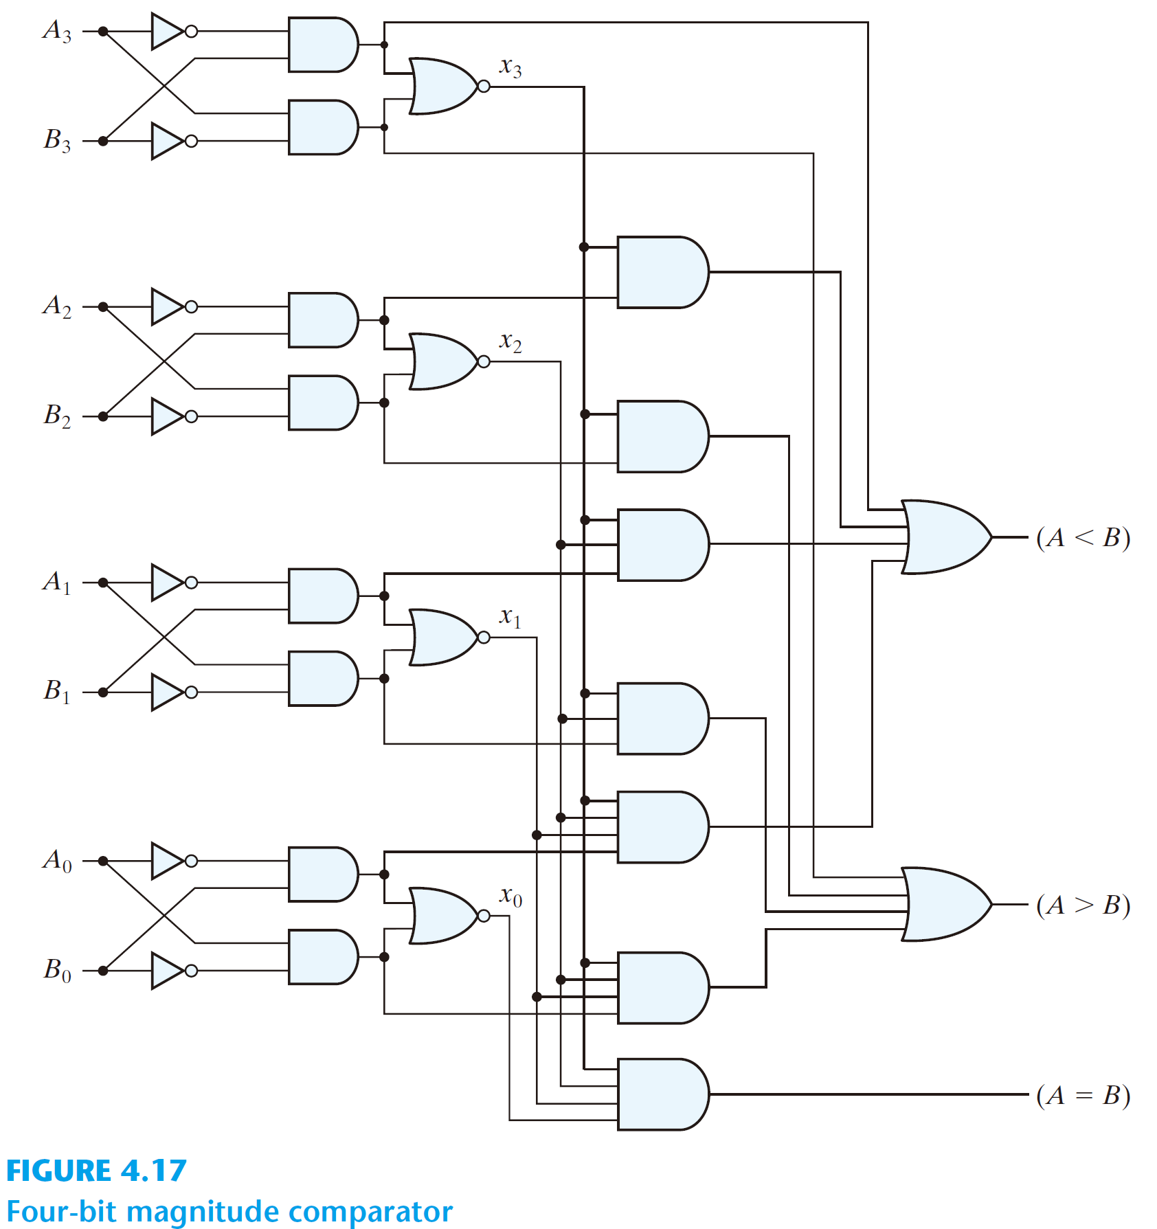
For 1-bit comparator:
A | B | (A > B) | (A = B) | (A < B)
0 | 0 | 0 | 1 | 0
0 | 1 | 0 | 0 | 1
1 | 0 | 1 | 0 | 0
1 | 1 | 0 | 1 | 0
A
Comparator
A > B
A = B
B
A < B
(A < B)
(A > B) = AB’
(A = B)
(A = B) = A’B’ + AB = (A’B + AB’)’
(A < B) = A’B
(A > B)

Slide 141
For 4-bit comparator:
  the truth table has 2⁸ entries: cumbersome

Slide 142
  A = A₃A₂A₁A₀ ; B = B₃B₂B₁B₀
  A = B if A₃ = B₃, A₂ = B₂, A₁ = B₁and A₁ = B₁
    equality: x_{i} = A_{i}B_{i} + A_{i}’B_{i}’, for i = 0, 1, 2, 3
    (A = B) = x₃x₂x₁x₀

Slide 144
x3
x2
x1
x0

Slide 145
x3
x2
x1
x0

Slide 146
x3
x2
x1
x0

Slide 147
  (A > B) = A₃B₃’ + x₃A₂B₂’ + x₃x₂A₁B₁’ + x₃x₂x₁ A₀B₀’

Slide 148
  (A > B) = A₃B₃’ + x₃A₂B₂’ + x₃x₂A₁B₁’ + x₃x₂x₁ A₀B₀’

Slide 149
  (A > B) = A₃B₃’ + x₃A₂B₂’ + x₃x₂A₁B₁’ + x₃x₂x₁ A₀B₀’
A₃ > B₃
A₂ > B₂
A₁ > B₁
A₀ > B₀

Slide 150
  (A > B) = A₃B₃’ + x₃A₂B₂’ + x₃x₂A₁B₁’ + x₃x₂x₁ A₀B₀’
A₃ > B₃
A₂ > B₂
A₁ > B₁
A₀ > B₀

Slide 151
  (A > B) = A₃B₃’ + x₃A₂B₂’ + x₃x₂A₁B₁’ + x₃x₂x₁ A₀B₀’
A₃ > B₃
A₂ > B₂
A₁ > B₁
A₀ > B₀

Slide 152
  (A > B) = A₃B₃’ + x₃A₂B₂’ + x₃x₂A₁B₁’ + x₃x₂x₁ A₀B₀’
A₃ > B₃
A₂ > B₂
A₁ > B₁
A₀ > B₀

Slide 153
  (A > B) = A₃B₃’ + x₃A₂B₂’ + x₃x₂A₁B₁’ + x₃x₂x₁ A₀B₀’
A₃ > B₃
A₂ > B₂
A₁ > B₁
A₀ > B₀

Slide 154
  (A > B) = A₃B₃’ + x₃A₂B₂’ + x₃x₂A₁B₁’ + x₃x₂x₁ A₀B₀’
A₃ > B₃
A₂ > B₂
A₁ > B₁
A₀ > B₀

Slide 155
  (A > B) = A₃B₃’ + x₃A₂B₂’ + x₃x₂A₁B₁’ + x₃x₂x₁ A₀B₀’
A₃ > B₃
A₂ > B₂
A₁ > B₁
A₀ > B₀

Slide 156
  (A < B) = A₃'B₃ + x₃A₂'B₂ + x₃x₂A₁'B₁ + x₃x₂x₁ A₀'B₀

Slide 157
  (A < B) = A₃'B₃ + x₃A₂'B₂ + x₃x₂A₁'B₁ + x₃x₂x₁ A₀'B₀

Slide 158
A₃ < B₃
  (A < B) = A₃'B₃ + x₃A₂'B₂ + x₃x₂A₁'B₁ + x₃x₂x₁ A₀'B₀
A₂ < B₂
A₁ < B₁
A₀ < B₀

Slide 159
A₃ < B₃
  (A < B) = A₃'B₃ + x₃A₂'B₂ + x₃x₂A₁'B₁ + x₃x₂x₁ A₀'B₀
A₂ < B₂
A₁ < B₁
A₀ < B₀

Slide 160
A₃ < B₃
  (A < B) = A₃'B₃ + x₃A₂'B₂ + x₃x₂A₁'B₁ + x₃x₂x₁ A₀'B₀
A₂ < B₂
A₁ < B₁
A₀ < B₀

Slide 161
A₃ < B₃
  (A < B) = A₃'B₃ + x₃A₂'B₂ + x₃x₂A₁'B₁ + x₃x₂x₁ A₀'B₀
A₂ < B₂
A₁ < B₁
A₀ < B₀

Slide 162
A₃ < B₃
  (A < B) = A₃'B₃ + x₃A₂'B₂ + x₃x₂A₁'B₁ + x₃x₂x₁ A₀'B₀
A₂ < B₂
A₁ < B₁
A₀ < B₀

Slide 163
A₃ < B₃
  (A < B) = A₃'B₃ + x₃A₂'B₂ + x₃x₂A₁'B₁ + x₃x₂x₁ A₀'B₀
A₂ < B₂
A₁ < B₁
A₀ < B₀

Slide 164
A₃ < B₃
  (A < B) = A₃'B₃ + x₃A₂'B₂ + x₃x₂A₁'B₁ + x₃x₂x₁ A₀'B₀
A₂ < B₂
A₁ < B₁
A₀ < B₀

Slide 165
x3
x2
x1
x0

Slide 166
  (A > B) = A₃B₃’ + x₃A₂B₂’ + x₃x₂A₁B₁’ + x₃x₂x₁ A₀B₀’
A₃ > B₃
A₂ > B₂
A₁ > B₁
A₀ > B₀

